Slide 1



credit card dashboard
View in Power BI
Last data refresh:
8/3/2024 6:57:35 PM UTC
Downloaded at:
8/3/2024 7:01:19 PM UTC

Slide 2
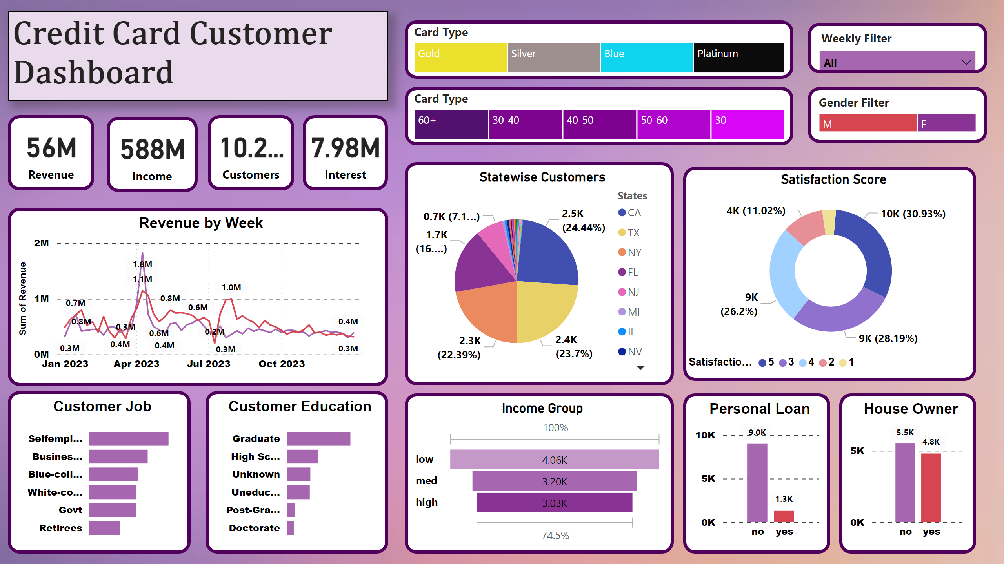
Page 3
Notes:
textbox
No alt text provided
Card Type
No alt text provided
slicer
No alt text provided
Gender Filter
No alt text provided
Card Type
No alt text provided
card
No alt text provided
card
No alt text provided
card
No alt text provided
card
No alt text provided
Satisfaction Score
No alt text provided
Revenue by Week
No alt text provided
House Owner
No alt text provided
Personal Loan
No alt text provided
Statewise Customers
No alt text provided
Income Group
No alt text provided
Customer Job
No alt text provided
Customer Education
No alt text provided

